Slide 1
Presentation on the topic of Queue
Presented By:
Sunita Bagale

Slide 2
Contents
Introduction
Queue as an ADT
Primitive operation in queue
Linear and circular queue and their applications
Enqueue and Dequeue
Priority queue

Slide 3
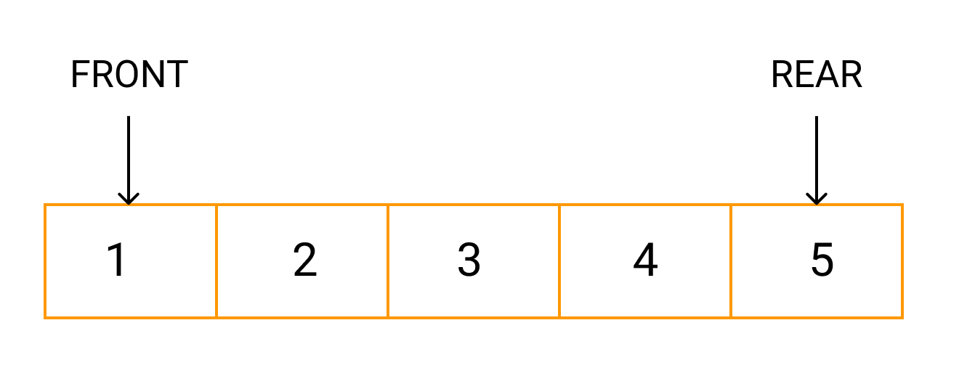
Queue
Queue is a linear data structure.
It is used for temporary storage of data values.
The existing elements deleted at one end called front end.
A new element is added at one end called rear end.
First-in-First-out property.

Slide 4
Queue as an ADT
MakeEmpty (q) = To make q as an empty queue.
IsEmpty (q) = check q is empty, if empty returns true or false.
IsFull (q) = Check q is full, if full return True or False.
Enqueue(q,x) = insert x at rear of the queue, if & only if q is not full.
Dequeue(q) = Delete item from front of the queue, if q is not empty.
Traverse (q) = To read entire queue that is display the content of the queue.

Slide 5
Primitive Operation in a queue
Enqueue
Dequeue

Slide 6
Enqueue
Adds an element at the beginning of the queue. If the queue is full, then it is an overflow.
Pseudocode:
Check if the queue is full.
If the queue is full, then print "Queue overflow".
If the queue is not full, increment rear pointer to point next empty space.
Add data element to the queue location, where the rear is pointing.
end
Algorithm:
If (rear == Max-1) //Queue is full
Printf (“queue overflow”);
Else if (front = rear = 1) //Queue is empty
front = rear = 0
else
rear = rear + 1
queue[rear] = data
end

Slide 7
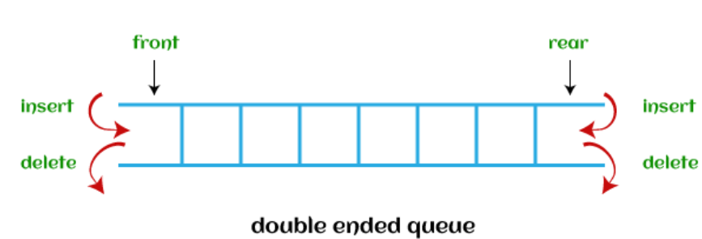
Dequeue
Dequeue stands for double ended queue.
Insertion and deletion operations can be done at both FRONT and END of the queue.
If the queue is empty, then it is an underflow.

Slide 8
Pseudocode
Check if the queue is empty.
If the queue is empty, the print "Queue underflow".
If the queue is not empty, access the data where front is pointing.
Increment front pointer to point to the next available data element.
End
Algorithm:
If (front == -1) //Queue is full
Printf (“queue underflow”);
Else if (front ==rear) //Queue has only one element
front = rear - 1
else
data = queue[front]
front = front + 1
end

Slide 9
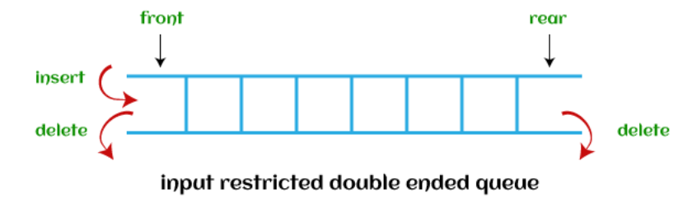
There are two types of dequeue that are discussed as follows -
Input restricted dequeue - As the name implies, in input restricted queue, insertion operation can be performed at only one end, while deletion can be performed from both ends.

Slide 10
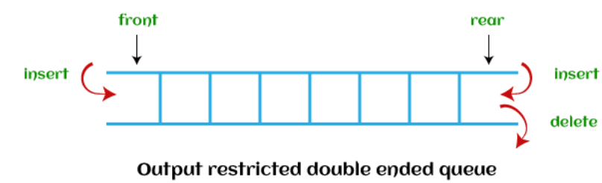
Output restricted dequeue - As the name implies, in output restricted queue, deletion operation can be performed at only one end, while insertion can be performed from both ends.

Slide 11
Implementation of queue
There are two techniques for implementing the queue:
Array implementation
Linked list implementation
Array Implementation of queue
Linear queue
Circular queue
Priority queue

Slide 12
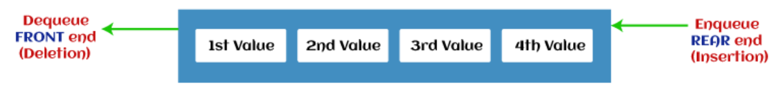
Linear queue
The simple queue is a normal queue where insertion takes place at the FRONT of the queue and deletion takes place at the END of the queue.

Slide 13
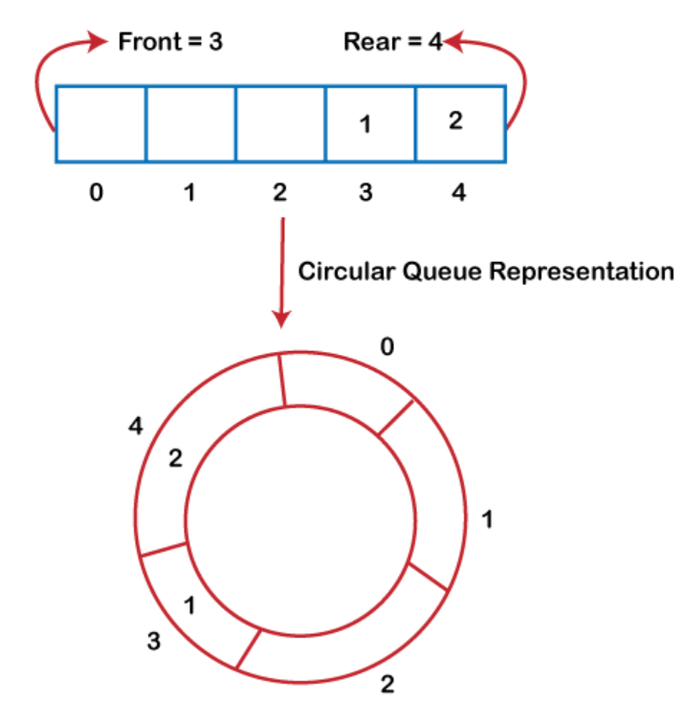
Circular queue
In a circular queue, the last node is connected to the first node.
Circular queue is also called as Ring Buffer.
Insertion in a circular queue happens at the FRONT and deletion at the END of the queue.

Slide 14
Application of Circular Queue:
Memory management: The circular queue provides memory management. As we have already seen that in linear queue, the memory is not managed very efficiently. But in case of a circular queue, the memory is managed efficiently by placing the elements in a location which is unused.
CPU Scheduling: The operating system also uses the circular queue to insert the processes and then execute them.
Traffic system: In a computer-control traffic system, traffic light is one of the best examples of the circular queue. Each light of traffic light gets ON one by one after every interval of time. Like red light gets ON for one minute then yellow light for one minute and then green light. After green light, the red light gets ON.

Slide 15
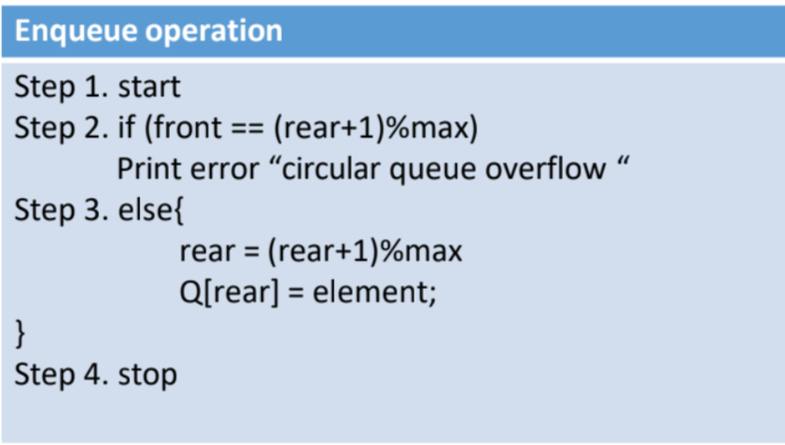
Operation in Circular Queue (Enqueue)
First, we will check whether the Queue is full or not.
Initially the front and rear are set to -1. When we insert the first element in a Queue, front and rear both are set to 0.
When we insert a new element, the rear gets incremented, i.e., rear=rear+1.
Algorithm:

Slide 16
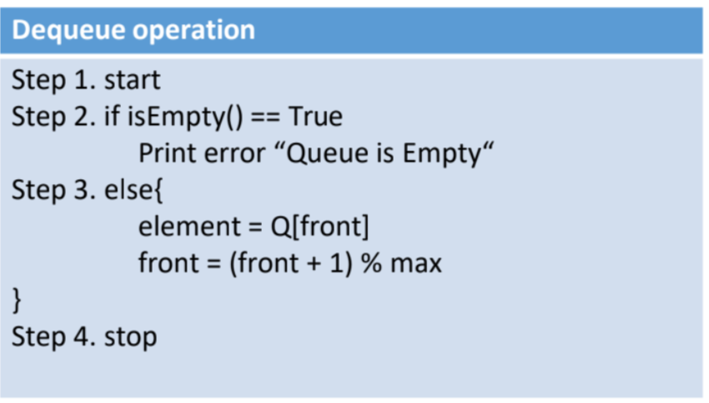
Operation in Circular Queue (Dequeue)
First, we check whether the Queue is empty or not. If the queue is empty, we cannot perform the dequeue operation.
When the element is deleted, the value of front gets decremented by 1.
If there is only one element left which is to be deleted, then the front and rear are reset to -1.
Algorithm:

Slide 17
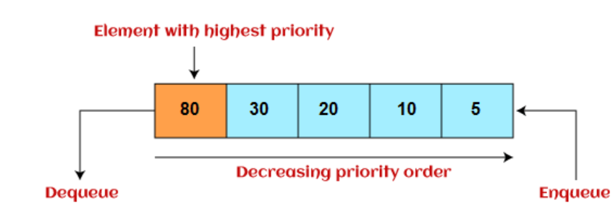
Priority queue
It is collection of elements where elements are stored according to their priority levels.
Inserting and removing of elements from queue is decided by the priority of the elements.
An element of the higher priority is processed first.
Two element of same priority are processed on first-come-first-served basis.

Slide 18
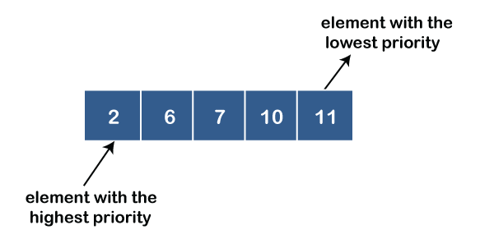
There are two types of priority queue:
In ascending order priority queue, a lower priority number is given as a higher priority in a priority. For example, we take the numbers from 1 to 5 arranged in an ascending order like 1,2,3,4,5; therefore, the smallest number, i.e., 1 is given as the highest priority in a priority queue.
Ascending priority queue –
In ascending order priority queue, a lower priority number is given as a higher priority in a priority. For example, we take the numbers from 1 to 5 arranged in an ascending order like 1,2,3,4,5; therefore, the smallest number, i.e., 1 is given as the highest priority in a priority queue.

Slide 19
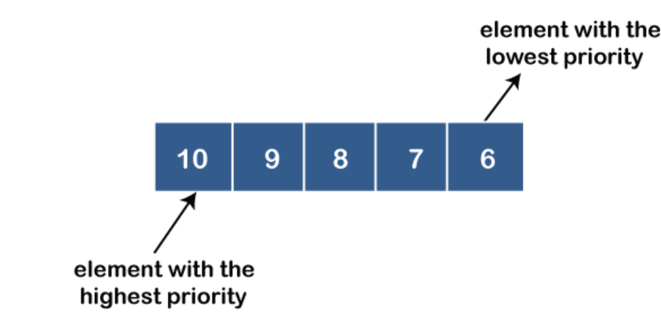
Descending priority queue -
In descending order priority queue, a higher priority number is given as a higher priority in a priority. For example, we take the numbers from 1 to 5 arranged in descending order like 5, 4, 3, 2, 1; therefore, the largest number, i.e., 5 is given as the highest priority in a priority queue.

Slide 20
Questions:
What is circular queue? Write an algorithm to insert an item in circular queue. [2020]
Define circular queue? How does circular queue overcome the limitation of linear queue? Explain. [2019]

Slide 21
Thank You!!!

